Slide 1

Subject: FUNDAMENTALS Of iOS APPLICATION DEVELOPMENT WITH SWIFT
Module Number - 1
Module Name: Swift Explorations

Slide 2
Swift Explorations
Syllabus
Introduction to iOS
iOS Versions
iOS Layers
iOS Features
Introduction to MAC OS
Types Of Mac OS
Versions of MAC OS
Introduction to Swift
Swift Features
Playgrounds
Constants and Variables
Swift Language syntax
Data Types
Strings
Operators
Control Flow & Control Transfer Statements

Slide 3
Swift Explorations
AIM:
To understand the concept’s iOS, MACOS, Swift Programming Language Basics

Slide 4
Swift Explorations
Objectives:
Study and understand the basics of iOS & MACOS
Study and understand about Xcode Tool Overview
Study and understand Basic Swift Fundamentals

Slide 5
Swift Explorations
Table of Contents:
Introduction to iOS
iOS Versions
iOS Layers
iOS Features
Introduction to MAC OS
Types Of Mac OS
Versions of MAC OS
Introduction to Swift
Swift Features
Playgrounds
Constants and Variables
Swift Language syntax
Data Types
Strings
Operators
Control Flow Statements
Control Transfer Statements

Slide 6
Introduction to iOS
Swift Explorations
What is iOS?
iOS (known as iPhone OS) is Apple's mobile operating system.
The operating system was unveiled with the iPhone on January 9, 2007, and released in June of that year
Originally developed for the iPhone, it has since been extended to support other Apple devices such as the iPod Touch, iPad and Apple TV.
To develop Apps for iOS Apple provides Objective-C & Swift programming Language for Developers

Slide 7
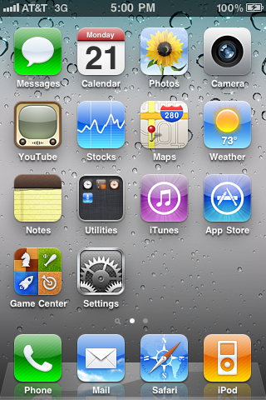
iOS HOME PAGE
Swift Explorations
Overview of iOS:

Slide 8
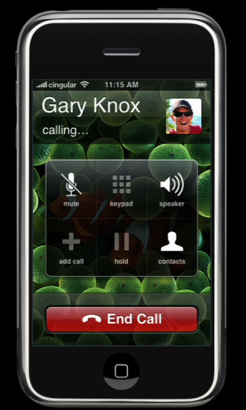
PHONE
Swift Explorations

Slide 9
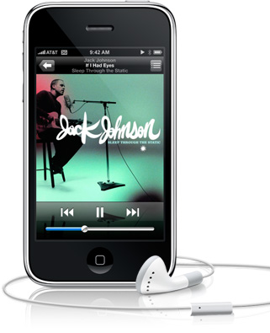
MULTIMEDIA
Swift Explorations

Slide 10
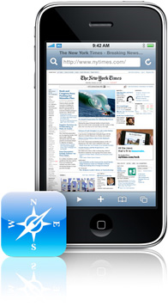
INTERNET CONNECTIVITY
Swift Explorations
Safari Browser

Slide 11
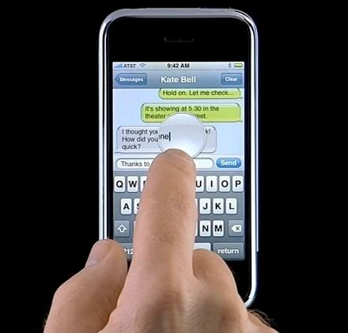
TEXT INPUT
Swift Explorations

Slide 12
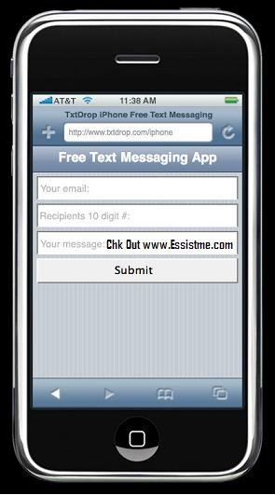
EMAILS & TEXT MESSAGES
Swift Explorations

Slide 13
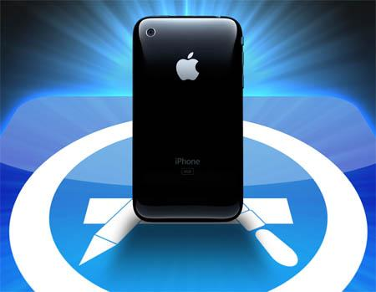
APPSTORE
Swift Explorations
The Apple App Store is a service for iOS devices (the iPhone, iPod Touch and iPad) offered by Apple Inc.
The App Store opened on July 10, 2008 via an update to iTunes.
The App Store is accessible from the iPhone, iPod Touch and iPad.
The store is also accessible on computers running Mac OS X and Windows through iTunes.

Slide 14
APPLE SAY’s
Swift Explorations
Apple allows 70% of revenues from the store to instantly go to the seller of the application, and 30% go to Apple.
Billion’s of apps was downloaded from Apple App Store.

Slide 15
APPROVAL PROCESS
Swift Explorations
To get applications into the App Store, developers were required to submit their app and wait for approval or rejection by Apple.
Rejected apps were given feedback on the reason they were rejected so they could be modified and resubmitted.

Slide 16
Swift Explorations
iOS Versions
1. iOS 1
Released on June 29, 2007
New Key Features
1. Music app
2. Safari browser
3. Multi-touch interface
4. Visual voicemail

Slide 17
Swift Explorations
2. iOS 2
Released on July 11, 2008
New Key Features
1. Improved Maps App
2. App Store
3. iOS 3
Released on June 17, 2009
New Key Features
1. Recording Videos
2. Spotlight Search
3. Copy & Paste

Slide 18
Swift Explorations
4. iOS 4
Released on June 21, 2010
New Key Features
1. Multitasking
2. FaceTime
3. AirPlay
4. AirPrint
5. iBooks
6. Personal Hotspot

Slide 19
Swift Explorations
5. iOS 5
Released on October 12, 2011
New Key Features
1. iMessage
2. iCloud
3. Notification Center
6. iOS 6
Released on September 19, 2012
New Key Features
1. Passbook
2. Apple maps
3. Do Not Disturb

Slide 20
Swift Explorations
7. iOS 7
Released on September 18, 2013
New Key Features
1. AirDrop
2. Touch Id
3. CarPlay
8. iOS 8
Released on September 17, 2014
New Key Features
1. Apple Pay
2. iCloud Drive
3. HomeKit

Slide 21
Swift Explorations
9. iOS 9
Released on September 16, 2015
New Key Features
1. Low Power Mode
2. Night Shift
10. iOS 10
Released on July 13, 2016
New Key Features
1. iMessage apps
2. Delete built-in apps

Slide 22
Swift Explorations
11. iOS 11
Released on September 19, 2017
New Key Features
1. AirPlay 2
2. Major enhancement on iPad
3. Augmented Reality
12. iOS 12
Released on September 17, 2018
New Key Features
1. Grouped Notifications
2.Screen Time
3.ARKit 2
4.Siri improvements, including Siri Shortcuts and multi-step actions
5. Memoji, a personalized kind of Animoji

Slide 23
Swift Explorations
13. iOS 13
Released on September 19, 2019
New Key Features
1. System-wide Dark Mode
2. Sign In With Apple user account system
3. New privacy and security options
4. New Portrait Lighting options
5. Look Around, a Google Street View-style feature for Apple Maps
6. New, improved Siri voice
7. Overhauled stock apps like Reminders and Notes

Slide 24
Swift Explorations
14. iOS 14
Released on September 17, 2020
New Key Features
1. Homescreen Widgets for customized home screens and shortcuts.
2. Smart Stacks that deliver different Home screen Widgets at different times of the day based on your habits.
3. Set third-party apps as default for email and web browser apps.
4. App Library, a new way of organizing apps and keeping your home screen neat.
5. Built-in language translation for 11 languages.
6. Spatial audio for AirPods delivers surround sound, along with other AirPods improvements.

Slide 25
Swift Explorations
14. iOS 15
Released on September 24, 2021
New Key Features
FaceTime received numerous improvements aimed at improving the experience of using the app and expanding the audience for it, including:
a) SharePlay allows people on a FaceTime video call to watch video or listen to audio together, and share screens
b) Spatial Audio brings Apple's more-natural, 3D audio experience to improve the naturalness of FaceTime sound
c) Enhanced Mic Modes allow you to isolate your voice from background noise to improve audio quality
d) Portrait Mode brings this terrific still-photos feature to video to blur your background
e) Cross-Platform support allows you to invite anyone to a FaceTime call with a link and for them to join from a web browser or Android devices.

Slide 26
Swift Explorations
2. Focus adds a set of smart notification and communication s settings based on what you're doing at that moment.
3. The Photos app gains major improvements such as:
a) Live Text lets the app detect text inside your photos and convert it to text that can be copied and pasted, or phone numbers that can be tapped to call
b) Visual search lets you search within the Photos app for text embedded your photos.
4. In keeping with Apple's ongoing commitment to user privacy, iOS 15 adds:
a) App Privacy Report lets you know what permissions each of your apps has, how often it accesses your data, and what third-party domains the app has contacted.
b) Mail Privacy Protection blocks tracking pixels, hides your IP address from marketers, and blocks the connection of your data from email with other data sources.
c) On-device Siri means that Siri recordings are no longer sent to or stored in the cloud. Siri works completely on your iPhone, and now works offline.

Slide 27
Swift Explorations
5. Support for the iCloud+ service that adds new Homekit and VPN-style features.
6. Notifications scheduling and summary.
7. Improved driving directions in Maps.
8. A redesigned experience and features for managing tabs and groups of tabs in Safari.
9. Better ways to find content shared with you and to share medical data from the Health app with your family

Slide 28
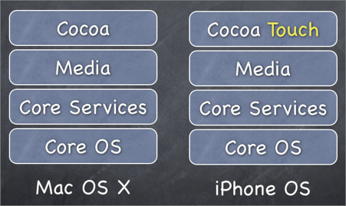
iOS Layers
Swift Explorations

Slide 29
Swift Explorations
1. Core OS Layer:
The bottom layer is the Core OS, which is the foundation of the operating system. It is in charge of memory management, the file system, networking, and other OS tasks, and it interacts directly with the hardware. The Core OS layer consists of components such as the following:
➤ OS X Kernel
➤ Mach 3.0 (kernel)
➤ BSD (Berkeley Software Distribution)
➤ Sockets
➤ Security
➤ Power Management (Battery)
➤ Keychain Certificates (A certificate is a document that Apple issues to you. This certificate states that you are a trusted developer and that you are in fact, who you claim to be, rather than someone else posing as you)
➤ File System
➤ Bonjour (Apple Bonjour is a group of networking technologies designed to help devices and applications discover each other on the same network.)

Slide 30
Swift Explorations
2. Core Services:
The Core Services layer provides an abstraction over the services provided in the Core OS layer. It provides fundamental access to iOS services and consists of the following components:
➤ Collections
➤ Address Book
➤ Networking
➤ File Access
➤ SQLite
➤ Core Location
➤ Net Services
➤ Threading
➤ Preferences
➤ URL Utilities

Slide 31
Swift Explorations
3. Media Layer:
The Media layer provides multimedia services that you can use in your iPhone and iPad applications. It consists of the following components:
➤ Core Audio
➤ OpenGL
➤ Audio Mixing
➤ Audio Recording
➤ Video Playback
➤ JPG, PNG, TIFF
➤ PDF
➤ Quartz
➤ Core Animation
➤ OpenGL ES

Slide 32
Swift Explorations
4. COCOA TOUCH LAYER:
The Cocoa Touch layer provides an abstraction layer to expose the various libraries for programming the iPhone and iPad, such as the following:
➤ Multi-Touch events
➤ Multi-Touch controls
➤ Accelerometer
➤ View Hierarchy
➤ Localisation
➤ Alerts
➤ Web Views
➤ People Picker
➤ Image Picker
➤ View Controller

Slide 33
Swift Explorations
Note:
In iOS programming, all the functionalities in each layer are exposed through various frameworks that you will use in your project.
COCOA: A collections of Frameworks
Framework: its a software Library that provides some specific functionalities

Slide 34
Introduction to MAC OS
Swift Explorations
Mac OS is a series of graphical user interface-based operating systems developed by Apple Inc. for their Macintosh line of computer systems.
Graphical User Interface. (GUI)
Mac OS was the integral and unnamed system software first introduced in 1984 with the originalMacintosh.

Slide 35
Swift Explorations
Tasks require more explicit working knowledge of an operating system but on Macintosh it is accomplished by intuitive mouse gestures and manipulation of graphical control panels.
The core of the system software was held in ROM.
The user's involvement in an upgrade of the operating system was also minimized to running an installer.

Slide 36
Swift Explorations
History of Mac OS
The Macintosh project started in early 1979 with Jef Raskin.
The original Macintosh system software was partially based on the Lisa OS.
Also used concepts from the Xerox PARC, Xerox Alto.
Steve Jobs and a number of Apple engineers visited Xerox PARC in December 1979.
In January 1981, Steve Jobs completely took over the Macintosh project.
The final Lisa and Macintosh operating systems mostly used concepts from the Xerox Alto.
Many elements of the graphical user interface were created by Apple.

Slide 37


Xerox Alto – the first computer to use the desktop & GUI
Swift Explorations

Slide 38
Types Of MAC OS
Swift Explorations
Mac OS can be divided into Four families:
Mac OS Classic , which was based on Apple's own code.
Mac OS X , developed from Mac OS Classic and NeXTSTEP, which was UNIX-based.
MAC OS 11 Bigsur
MAC OS 12 Monterey

Slide 39
Mac OS Classic
Swift Explorations
Mac OS Classic is a series of operating systems based on Apple's own code and graphical user interfaces developed, marketed, and sold by Apple Inc.
Since 1984, Mac OS has been included with all new Macintosh computer systems.
The final release of the classic Mac OS, which had been Apple's primary operating system was in 1999.

Slide 40
Swift Explorations
The Mac OS classic is characterized by its total lack of a command line.
Versions of Mac OS up through System 4 only ran one application at a time.
Mac OS gained cooperative multitasking with System 5 version.
The Macintosh originally used the Macintosh File System (MFS), a flat file system with only one level of folders. This was quickly replaced by the Hierarchical File System (HFS) in 1985 , which had a true directory tree

Slide 41
Swift Explorations
Release of Mac OS Classic
There has been ten significant releases of the namely:
System 1
System 2
System 3
System 4
System 5
System 6
System 7
Mac OS 7.6
Mac OS 8
Mac OS 9

Slide 42
Mac OS X
Swift Explorations
Mac OS X is the newest of Apple Inc.'s Mac OS line of operating systems. Although it is officially designated as simply "version 10" of the Mac OS, it has a history largely independent of the earlier Mac OS releases.
Mac OS X is a series of Unix-based operating system and graphical user interfaces developed, marketed, and sold by Apple Inc.
Since 2002, Mac OS X has been included with all new Macintosh computer systems. It is the successor to Mac OS 9, released in 1999.
Mac OS X, where X is the Roman numeral for 10.
Mac OS X is also the basis for iOS, (previously iPhone OS) used on Apple's iPhone, iPod Touch, and iPad.

Slide 43
Release of Mac OS X
Swift Explorations
There have been sixteen significant releases of the client version namely:
Mac OS X v10.0 (Cheetah)
Mac OS X v10.1 (Puma)
Mac OS X v10.2 (Jaguar)
Mac OS X v10.3 (Panther)
Mac OS X v10.4 (Tiger)
Mac OS X v10.5 (Leopard)
Mac OS X v10.6 (Snow Leopard)
Mac OS X v10.7 (Lion)
Mac OS X v10.8 (Mountain Lion)
Mac OS X v10.9 (Mavericks)
Mac OS X v10.10 (Yosemite)
Mac OS X v10.11 (EI Captain)
Mac OS X v10.12 (Sierra)
Mac OS X v10.13 (High Sierra)
Mac OS X v10.14 (Mojave)
Mac OS X v10.15 (Catalina)

Slide 44
Introduction To Swift
Swift Explorations
Swift is a programming language that was introduced by Apple at the World WidebDevelopers Conference (WWDC) in 2014.
Swift is a programming language that is multi-paradigm, general-purpose, and compiled. This language was specifically developed for macOS, iOS, tvOS, Linux, watchOS.
The language was created by Apple Incorporation and is designed with the aim of working with Cocoa Touch, Cocoa frameworks and an extensive set of Objective-C codes that have been written for the products of Apple Incorporation.

Slide 45
Swift Explorations
History of Swift
Chris Lattner began the development of Swift in the year 2010 and collaborated with other programmers at Apple in the course of the development of this language.
The language ideas for Swift were taken from Rust, Objective-C, Ruby, Haskell, C#, CLU, Python, and a range of other programming languages.
The release of Apple Worldwide Developers Conference (WWDC) application in the year 2014, marked the formal introduction of an app written in Swift.
A manual of 500 page – called The Swift Programming Language – was also provided to the developers at the conference for free. It is also available of iBook and official website of Apple Incorporation.

Slide 46
Swift Features
Swift Explorations
When Apple first introduced Swift, it said that Swift is Objective-C without the C. This really only tells us half of the story. Objective-C is a superset of C and provides object-oriented capabilities and a dynamic runtime to the C language. This meant that with Objective-C, Apple needed to maintain compatibility with C, which limited the enhancements it could make to the Objective-C language.
As an example, Apple could not change how the switch statement functioned and has still maintained compatibility with the C language.Since Swift does not need to maintain the same C compatibility as Objective-C, Apple was free to add any feature/enhancement to the language.
This allowed Apple to include the best features from many of today's most popular and modern languages, such as Objective-C, Python, Java, Ruby, C#, and Haskell.

Slide 47
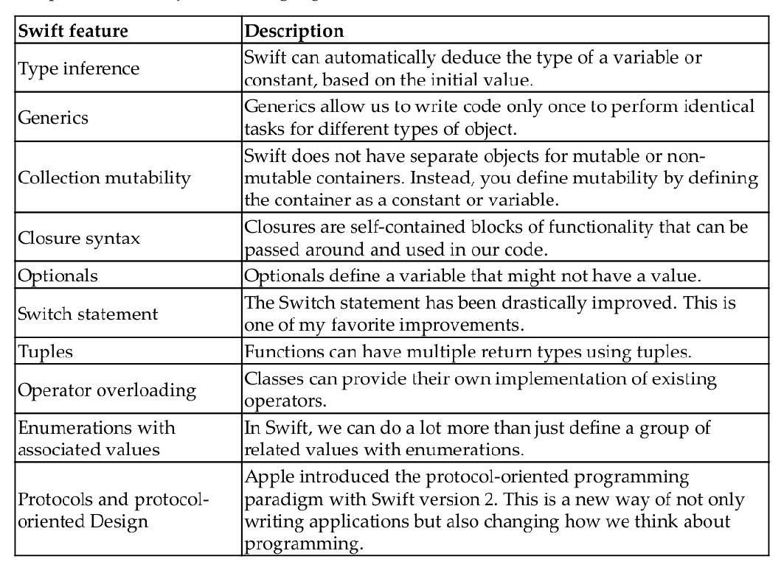
Swift Explorations
The following chart shows a list of some of the most exciting enhancements that Swift offers compared to the Objective-C language:

Slide 48
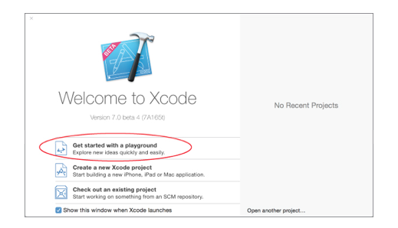
Xcode Playgrounds
Swift Explorations
Playgrounds are a new feature of Xcode (available from versions 6 and above) that allow you to rapidly prototype Swift code. You cannot create a complete app in a playground, but if you want to quickly try out an algorithm or just want to get a feel for the Swift programming language, then playgrounds are for you.
To create a playground, you can either select the Get started with a playground option in the Xcode welcome screen, or select the File-->New-->Playground menu item.

Slide 49
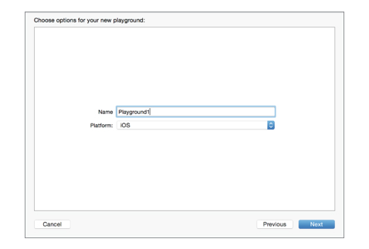
Swift Explorations
Xcode will then ask you to provide a name for the playground as well as the platform.

Slide 50
Swift Explorations
A playground can have several sections, but the three that we will be using extensively in this book are the following:
Coding Area: This is where you enter your Swift code.
Results Sidebar: This is where the results of your code are shown. Each time you
type in a new line of code, the results are re-evaluated, and the Results Sidebar
is updated with the new results.
Debug Area: This area displays the output of the code, and it can be very useful
for debugging.

Slide 51
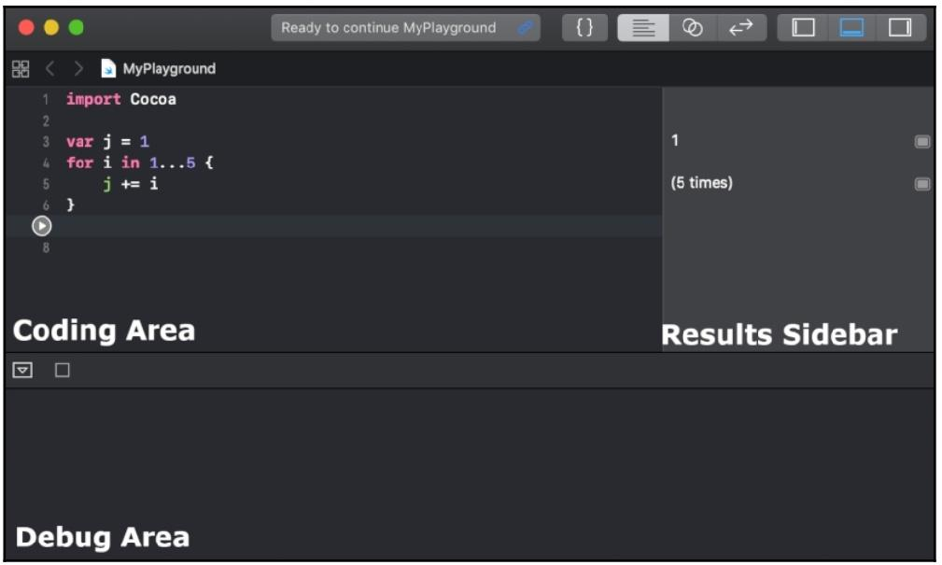
Swift Explorations
The following screenshot shows how these sections are arranged in a playground

Slide 52
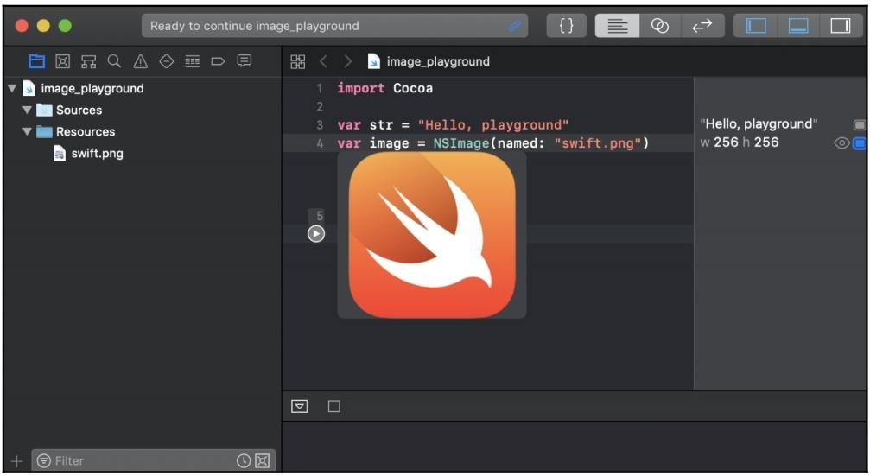
Swift Explorations
Showing images in a playground

Slide 53
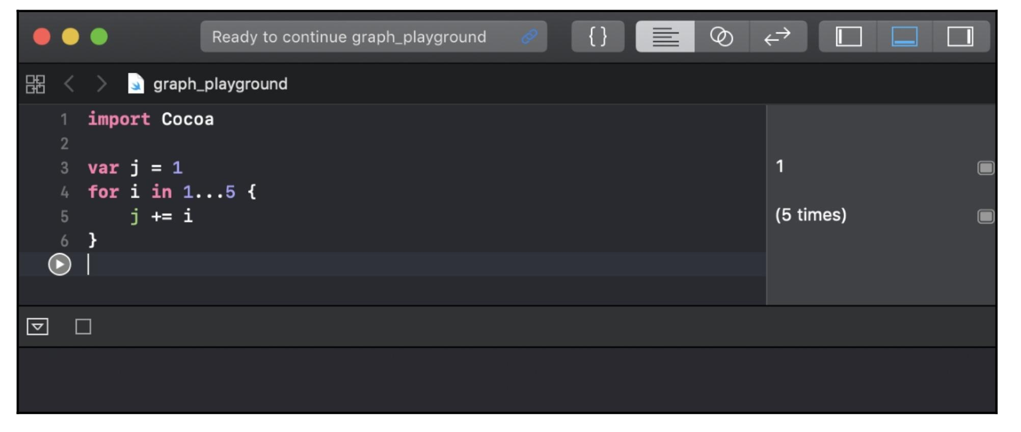
Creating and displaying graphs in playgrounds
Swift Explorations

Slide 54
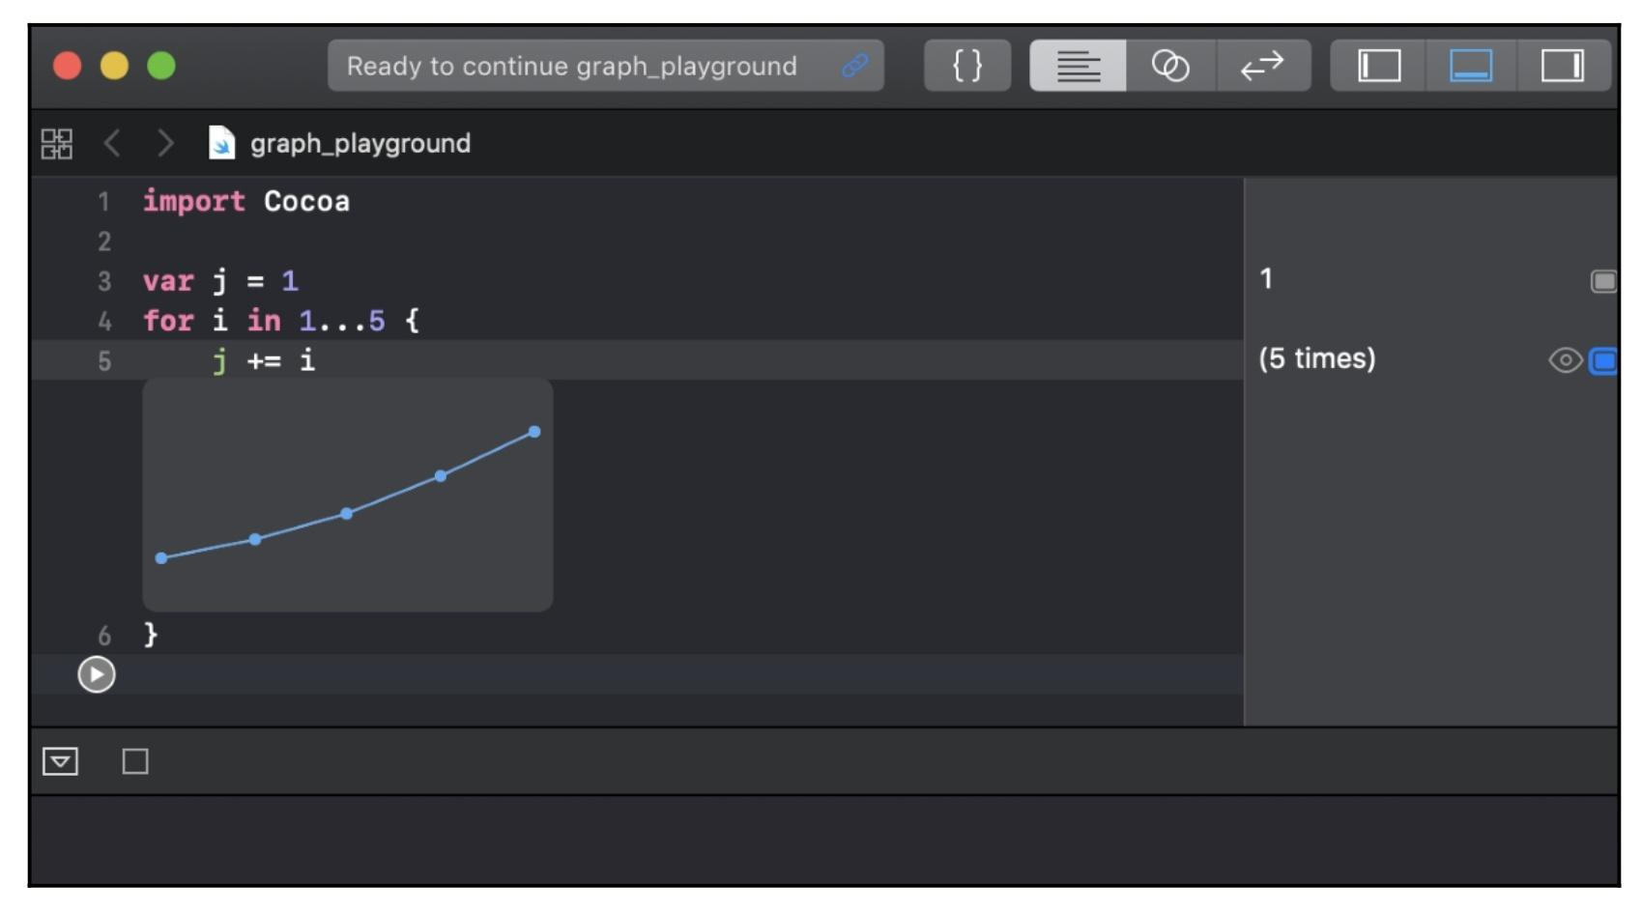
Swift Explorations

Slide 55
Swift Explorations
What playgrounds are not
There is a lot more that we can do with playgrounds, and we have only scratched the surface in our quick introduction here. Before we leave this brief introduction, let's take a look at what playgrounds are not so that we can better understand when not to use playgrounds:
Playgrounds should not be used for performance testing: The performance you see from any code that is run in a Playground is not representative of how fast the code will run when it is in your project.
Playgrounds do not support on-device execution: You cannot run the code that is present in a playground as an external application or on an external device

Slide 56
Swift language syntax
Swift Explorations
The Swift language uses modern concepts and syntax to create very concise and readablecode. There is also a heavy emphasis on eliminating common programming mistakes.
Before we get into the Swift language itself, let's look at some of the basic syntax of the
Swift language.
Comments
Writing comments in Swift code is a little different from writing comments in Objective-C code. We can still use the double slash // for single-line comments and the /** and */ for multiline comments; however, if we want to use the comments to also document our code, we need to use the triple slash (///) or multiline comment block

Slide 57
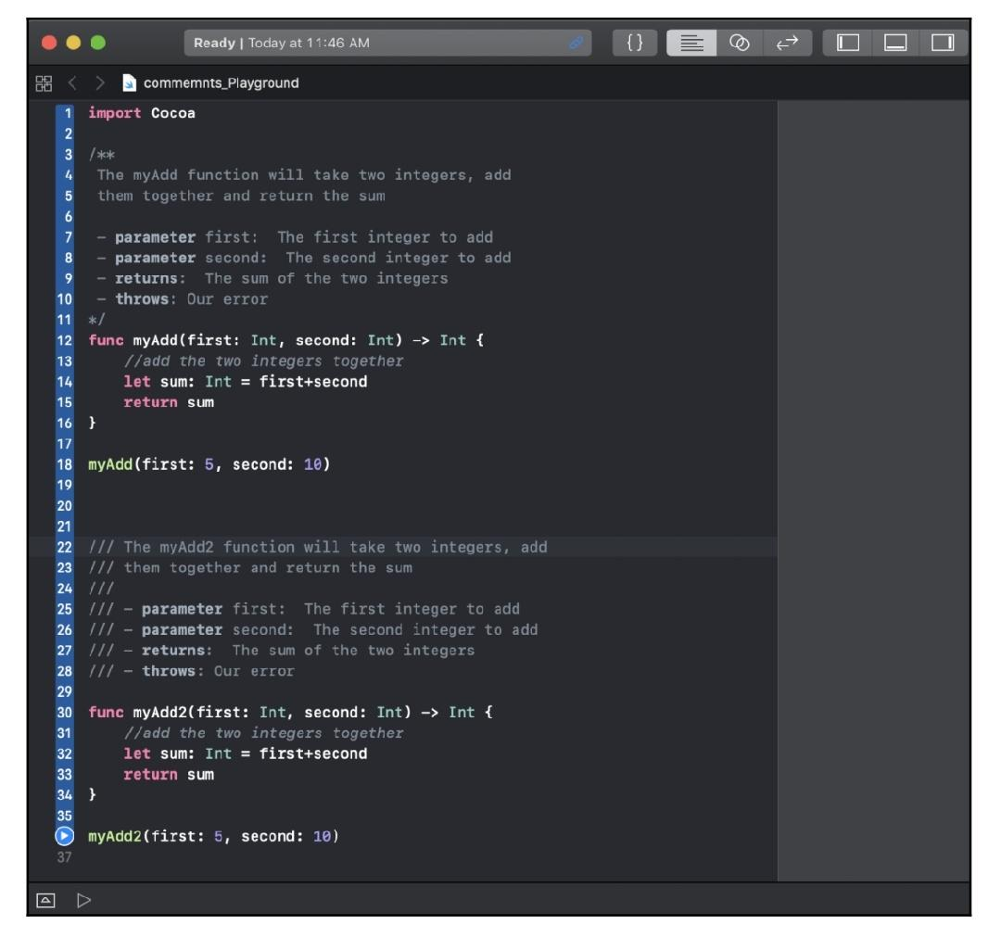
Swift Explorations
The following playground shows examples of both single-line and multiline comments and how to use the comment fields:

Slide 58
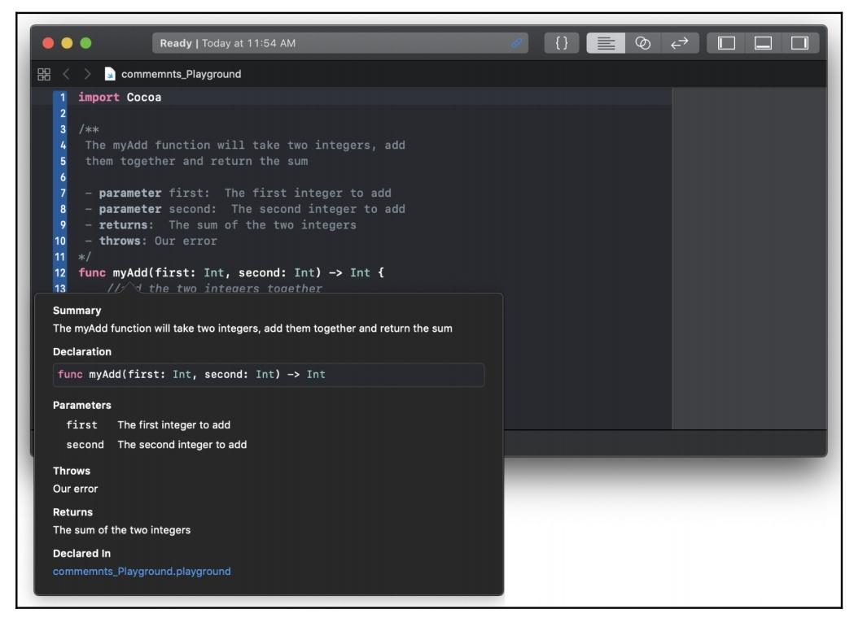
Swift Explorations
To write good comments, I would recommend using single-line comments within a function to give quick one-line explanations of your code. We then use multiline comments outside functions and classes to explain what the function and class do. The preceding playground shows a good way to use comments. By using proper documentation,as we did in the preceding screenshot, we can use the documentation feature within Xcode. If we hold down the option key and then click on the function name anywhere in our code, Xcode will display a popup with the description of the function.

Slide 59
Swift Explorations
We can see that the documentation contains five fields. These fields are as follows:
Declaration: This is the function's declaration.
Description: This is the description of the function as it appears in the comments Parameters. The parameter descriptions are prefixed with the Parameters: tag in the comment section.
Throws: The throws description is prefixed with the Throws tag and describes what errors are thrown by the methods.
Returns: The return description is prefixed with the Returns: tag in the
comment section.
Declared In: This is the file that the function is declared in so that we can easily find it.

Slide 60
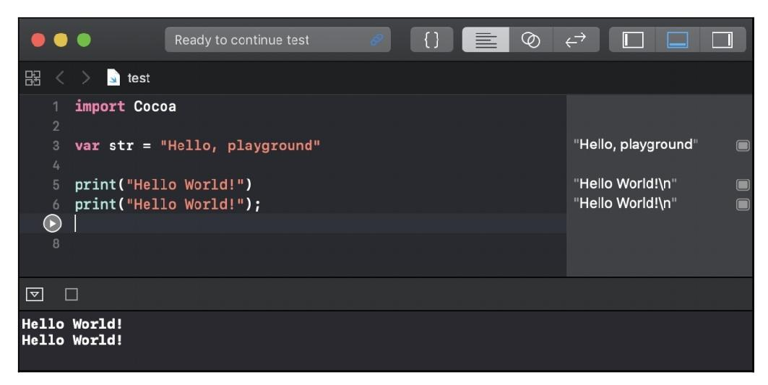
Swift Explorations
2. Semicolons
You may have noticed, from the code samples so far, that we are not using semicolons at the end of lines. The semicolons are optional in Swift; therefore, both lines in the following playground are valid in Swift:

Slide 61
Swift Explorations
For style purposes, it is strongly recommended that you do not use semicolons in your Swift code. If you are really set on using semicolons, be consistent and use them on every line of code; however, there is no warning if you forget them.
NOTE: I will stress this again: it is recommended that you do not use semicolons
in Swift.

Slide 62
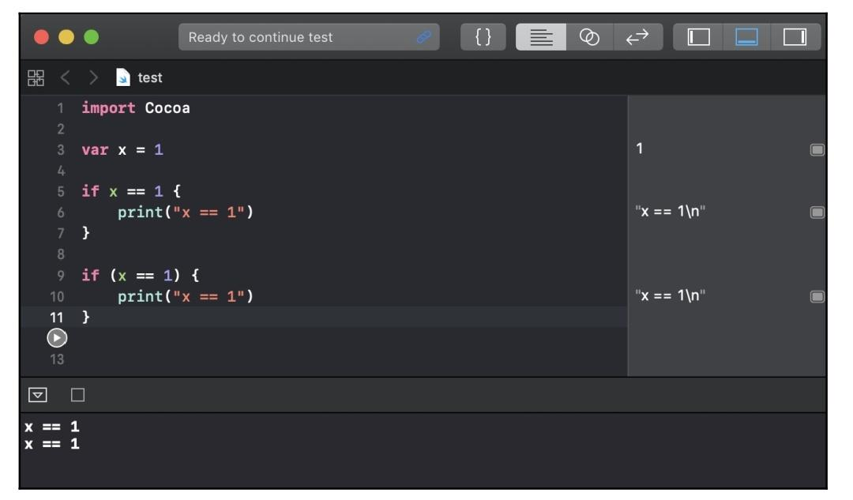
Swift Explorations
3. Parentheses:
In Swift, parentheses around conditional statements are optional; for example, both if statements in the following playground are valid:
For style purposes, it is recommended that you do not include parentheses in your code unless you have multiple conditional statements on the same line. For readability purposes, it is good practice to put parentheses around the individual conditional statements that are on the same line.

Slide 63
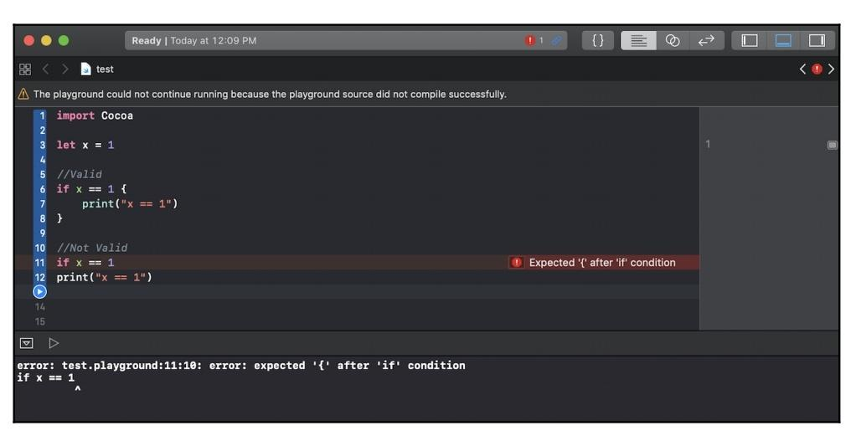
Swift Explorations
4. Curly brackets
In Swift, unlike most other languages, the curly bracket is required after conditional or loop statements. This is one of the safety features that is built into Swift. Arguably, there have been numerous security bugs that may have been prevented if the developer had used curly brackets. These bugs could have also been prevented by other means, such as unit testing and code reviews, but requiring developers to use curly brackets, in my opinion, is a good security standard.
The following playground shows you the error you get if you forget to include curly brackets:

Slide 64
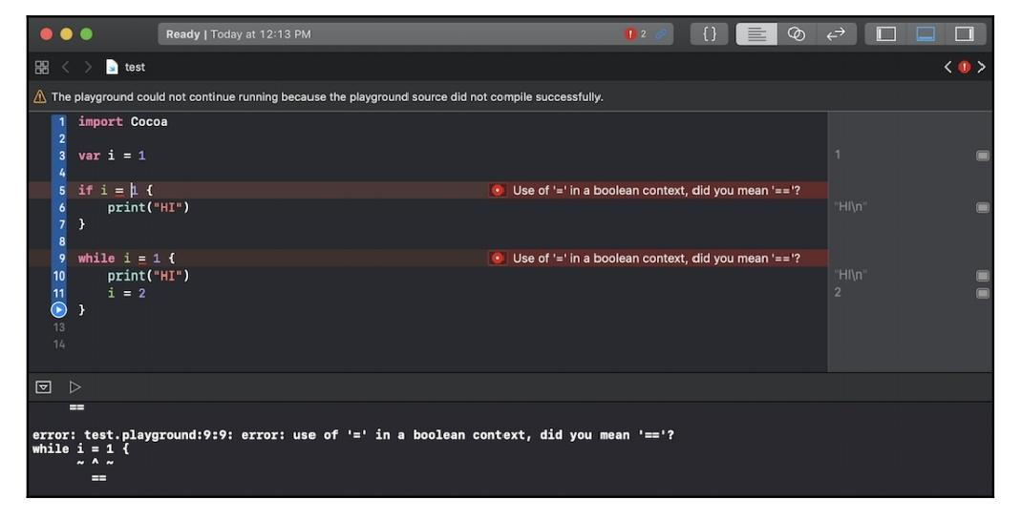
Swift Explorations
5. An assignment operator does not return a value
In most other languages, the following line of code is valid, but it probably isn't what the developer meant to do:
if (x = 1) {}
In Swift, this statement is not valid. Using an assignment operator (=) in a conditional statement (if, while, and guard) will throw an error. This is another safety feature built into Swift. It prevents the developer from forgetting the second equals sign (=) in a comparison statement. This error is shown in the following playground:

Slide 65
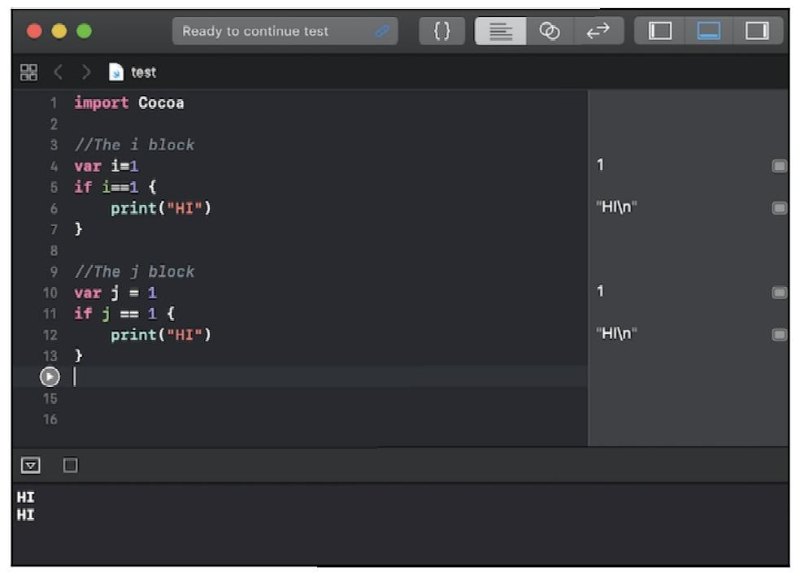
Swift Explorations
6. Spaces are optional in conditional and assignment statements
For both conditional (if and while) and assignment (=) statements, the white spaces are optional. Therefore, in the following playground, both the i and the j blocks of code are valid:
For style purposes, I recommend adding the white spaces as the j block shows (for readability) but, as long as you pick one style and are consistent, either style is acceptable.

Slide 66
Constants and variables
Swift Explorations
Constants and variables associate an identifier (such as myName or currentTemperature) with a value of a particular type (such as the String or Integer type), where the identifier can be used to retrieve the value. The difference between a constant and a variable is that a variable can be updated or changed, while a constant cannot be changed once a value is assigned to it.
Defining constants and variables
Constants and variables must be defined prior to using them. To define a constant, you use the let keyword, and to define a variable, you use the var keyword. The following code shows how to define both constants and variables:
// Constants
let freezingTemperatureOfWaterCelsius = 0
let speedOfLightKmSec = 300000
// Variables
var currentTemperature = 22
var currentSpeed = 55

Slide 67
Swift Explorations
We can declare multiple constants or variables in a single line by separating them with a comma. For example, we could shrink the preceding four lines of code down to two lines, as shown here:
// Constants
let freezingTempertureOfWaterCelsius = 0, speedOfLightKmSec = 300000
// Variables
var currentTemperture = 22, currentSpeed = 55

Slide 68
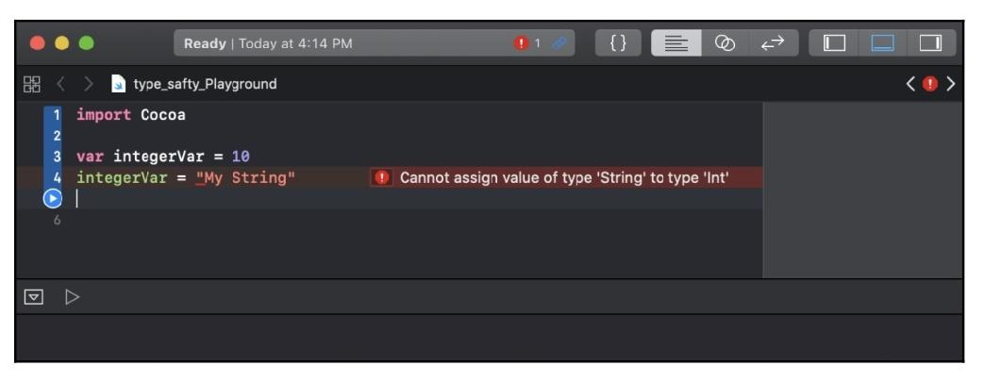
Swift Explorations
Type safety
Swift is a type-safe language, which means we are required to define the types of the values we are going to store in a variable. We will get an error if we attempt to assign a value to a Variable that is of the wrong type. The following playground shows what happens if we attempt to put a string value into a variable that expects integer values:

Slide 69
Swift Explorations
Type inference
Type inference allows us to omit the variable type when the variable is defined with an initial value. The compiler will infer the type based on that initial value. For example, in Objective-C, we would define an integer like this:
int myInt = 1
This tells the compiler that the myInt variable is of the int type, and the initial value is the number 1.
In Swift, we would define the same integer as this:
var myInt = 1
Swift infers that the variable type is an integer because the initial value is an integer. Let's look at a couple more examples:
var x = 3.14 // Double type
var y = "Hello" // String type
var z = true // Boolean type
In the preceding example, the compiler will correctly infer that variable x is a Double, variable y is a String, and variable z is a Boolean, based on their initial values.

Slide 70
Swift Explorations
Explicit types
Type inference is a very nice feature in Swift, and is one that you will probably get used to very quickly. However, there are times when we would like to explicitly define a variable's type.
For example, in the preceding example, the variable x is inferred to be Double, but what if we wanted the variable type to be Float? We can explicitly define a variable type like this:
var x:Float = 3.14
Notice the Float declaration (the colon and the word Float) after the variable identifier. This tells the compiler to define this variable to be of the Float type and gives it an initial value of 3.14. When we define a variable in this manner, we need to make sure that the initial value is of the same type that we are defining the variable to be. If we try to give a variable an initial value that is of a different type than we are defining it as, we will receive an error. As an example, the following line will throw an error because we are explicitly defining the variable to be that of the Float type, even though we are trying to put a String value in it:
var x: Float = "My str"

Slide 71
Swift Data Types
Swift Explorations
Unlike C or Objective-C, Swift does not require you to specify a data type when you are declaring a constant or variable.
The Swift compiler uses type inference to work out the data type from the value you assign.
If, however, you wish to be explicit, you can specify the data type of a constant or variable while declaring them as follows:
let maximumScore:Int = 200
var bookCategory:String = "fiction"
Once a constant or variable has been created with a certain type, its type cannot be changed. lists some of the common data types in Swift.

Slide 72
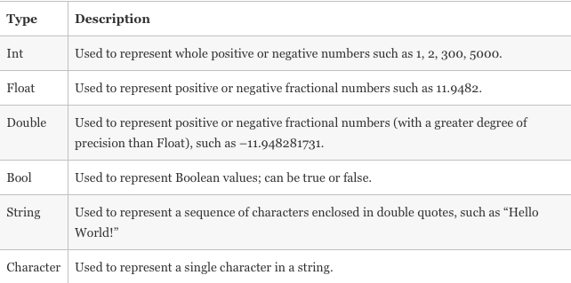
Swift Explorations
Common Swift Data Types

Slide 73
Swift Explorations
Swift Data Type Ranges
Following table shows the details like how much memory space occupied by a variable based on the data type and minimum & maximum values range for each data type.
Data Type | Memory Allocation | Min & Max Range
Int8 | 1byte | -127 to 127
UInt8 | 1byte | 0 to 255
Int32 | 4bytes | -2147483648 to 2147483647
UInt32 | 4bytes | 0 to 4294967295
Int64 | 8bytes | -9223372036854775808 to 9223372036854775807
UInt64 | 8bytes | 0 to 18446744073709551615
Float | 4bytes | 1.2E-38 to 3.4E+38 (~6 digits)
Double | 8bytes | 2.3E-308 to 1.7E+308 (~15 digits)

Slide 74
Strings
Swift Explorations
A string is an ordered collection of characters, such as Hello or Swift and is represented by the String type. We have seen several examples of strings in this book, and therefore the following code should look familiar. This code shows how to define two strings:
var stringOne = "Hello"
var stringTwo = " World"
We can also create a string using a multiline string literal. The following code shows how we can do that:
var multiLine = """
This is a multiline string literal.
This shows how we can create a string over multiple lines.
"""
Notice that we put three double quotes around the multiline string. We can use quotes in our multiline string to quote specific text. The following code shows how to do this:
var multiLine = """
This is a multiline string literal.
This shows how we can create a string over multiple lines.
Jon says, "multiline string literals are cool"
"""

Slide 75
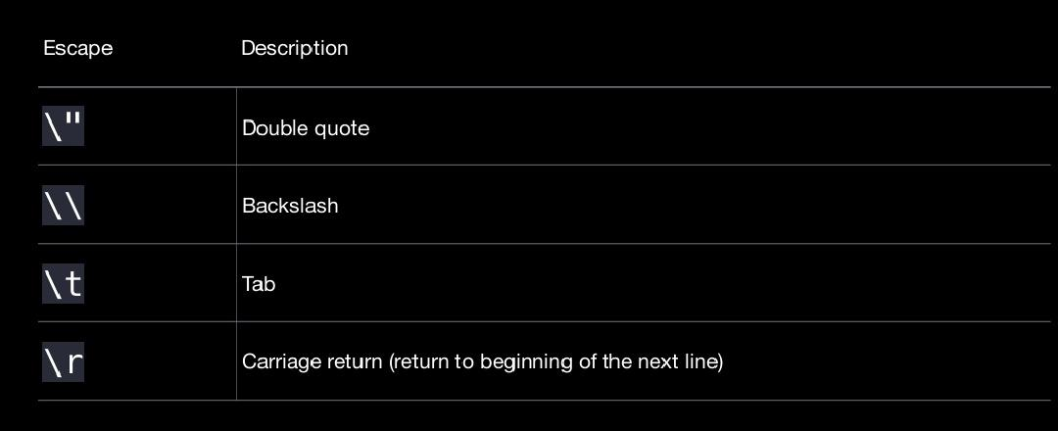
Swift Explorations
Strings Basics
Escaping
let greeting = "It is traditional in programming to print \"Hello, world!\""

Slide 76
Swift Explorations
Empty strings
var myString = ""
if myString.isEmpty {
print("The string is empty")
}
Characters
let a = "a" // 'a' is a string
let b: Character = "b" // 'b' is a Character

Slide 77
Swift Explorations
Concatenation
let string1 = "Hello"
let string2 = ", world!"
var myString = string1 + string2 // "Hello, world!"
myString += " Hello!" // "Hello, world! Hello!"
Interpolation
let name = "Rick"
let age = 30
print("\(name) is \(age) years old") // Rick is 30 years old
Interpolation Expressions
let a = 4
let b = 5
print("If a is \(a) and b is \(b), then a + b equals \(a+b)") // If a is 4 and b is 5, then a + b equals 9

Slide 78
Swift Explorations
String equality and comparison
let month = "January"
let otherMonth = "January"
let lowercaseMonth = "january"
if month == otherMonth {
print("They are the same") // They are the same.
}
if month != lowercaseMonth {
print("They are not the same.") //They are not the same.
}
String equality and comparison Ignoring case
let name = "Johnny Appleseed"
if name.lowercased() == "joHnnY aPPleseeD".lowercased() {
print("The two names are equal.")
}
// The two names are equal.
//

Slide 79
Swift Explorations
String equality and comparison Prefix and suffix
let greeting = "Hello, world!"
print(greeting.hasPrefix("Hello")) // true
print(greeting.hasSuffix("world!")) // true
print(greeting.hasSuffix("World!")) // false
String equality and comparison Finding substrings
let greeting = "Hi Rick, my name is Amy."
if greeting.contains("my name is") {
print("Making an introduction") // Making an introduction
}

Slide 80
Swift Explorations
String equality and comparison Checking length
let name = "Ryan Mears"
let count = name.count
let newPassword = "1234"
if newPassword.count < 8 {
print("This password is too short. Passwords should have at least 8 characters.")
}
// This password is too short. Passwords should have at least 8 characters.
String equality and comparison Using switch
let someCharacter: Character = "e"
switch someCharacter {
case "a", "e", "i", "o", "u":
print("\(someCharacter) is a vowel.")
default:
print("\(someCharacter) is not a vowel.") // e is a vowel.
}

Slide 81
Operators
Swift Explorations
An operator is a symbol or combination of symbols that we can use to check, change, or combine values. We have used operators in most of the examples so far in this book, but we did not specifically call them operators. In this section, we will show you how to use most of the basic operators that Swift supports.
Swift supports most standard C operators and also improves on some of them to eliminate several common coding errors. For example, the assignment operator does not return a value, which prevents it from being used where we are meant to use the equality operator, which is two equal signs (==).
Let's look at the operators in Swift.

Slide 82
Swift Explorations
Assignment operator
The assignment operator initializes or updates a variable. Here is a prototype:
var A = var B
Here is an example:
let x = 1
var y = "Hello"
a = b

Slide 83
Swift Explorations
2. Comparison operators
The comparison operator returns a Boolean value of true if the statement is true or a Boolean value of false if the statement is not true. Here are some prototypes:
Equality:
varA == varB
Not equal:
varA != varB
Greater than:
varA > varB
Less than:
varA < varB
Greater than or equal to:
varA >= varB
Less than or equal to:
varA <= varB

Slide 84
Swift Explorations
Here are some examples:
2 == 1 //false, 2 does not equal 1
2 != 1 //true, 2 does not equal 1
2 > 1 //true, 2 is greater than 1
2 < 1 //false, 2 is not less than 1
2 >= 1 //true, 2 is greater or equal to 1
2 <= 1 //false, 2 is not less or equal to 1

Slide 85
Swift Explorations
3. Arithmetic operators
The arithmetic operators perform the four basic mathematical operations. Here are some prototypes:
Addition:
varA + varB
Subtraction:
varA - varB
Multiplication:
varA * varB
Division:
varA / varB
Here are some examples:
var x = 4 + 2 //x will equal 6
var x = 4 - 2 //x will equal 2
var x = 4 * 2 //x will equal 8
var x = 4 / 2 //x will equal 2
var x = "Hello " + "world" //x will equal "Hello World"

Slide 86
Swift Explorations
4. Remainder operator
The remainder operator calculates the remainder if the first operand is divided by thesecond operand. In other languages, this is sometimes referred to as the modulo or modulus operator.
Here is a prototype:
varA % varB
Here is an example:
var x = 10 % 3 //x will equal 1
var x = 10 % 2.6 //x will equal 2.2

Slide 87
Swift Explorations
5. Compound assignment operators
The compound assignment operators combine an arithmetic operator with an assignment operator.
Here are some prototypes:
varA += varB
varA -= varB
varA *= varB
varA /= varB
Here are some examples:
var x = 6
x += 2 //x now is 8
x -= 2 //x now is 4
x *= 2 //x now is 12
x /= 2 //x now is 3

Slide 88
Swift Explorations
6. Closed range operator
The closed range operator defines a range that runs from the first number to the second number. The numbers are separated by three dots.
Here is a prototype:
(a...b)
Here is an example. Note that we will cover the for loop in Chapter 5, Control Flow:
for i in 1...3 {
print("Number: \(i)")
}
This example would print out the following:
Number: 1
Number: 2
Number: 3

Slide 89
Swift Explorations
7. Half open range operator
The half open range operator defines a range that runs form the first number to one, minus
the second number. The numbers are separated by two dots and the less than sign.
Here is a prototype:
(a..<b)
Here is a example:
for i in 1..<3 {
print("Number: \(i)")
}
This example would print out the following:
Number: 1
Number: 2

Slide 90
Swift Explorations
8. Ternary conditional operator
The ternary conditional operator assigns a value to a variable based on the evaluation of a comparison operator or Boolean value.
Here is a prototype:
(boolValue ? valueA : valueB)
Here is an example:
var x = 2
var y = 3
var z = (y >x ? "Y is greater" : "X is greater") //z equals "Y is greater"

Slide 91
Swift Explorations
9. Logical NOT operator
The logical NOT operator inverts a Boolean value. Here is a prototype:
varA = !varB
Here is an example:
var x = true
var y = !x //y equals false
10. Logical AND operator
The logical AND operator returns true if both operands are true; otherwise, it returns false.
Here is a prototype:
varA && varB
Here is an example:
var x = true
var y = false
var z = x && y //z equals false

Slide 92
Swift Explorations
11. Logical OR operator
The logical OR operator returns true if either of the operands are true. Here is a prototype:
varA || varB
Here is an example:
var x = true
var y = false
var z = x|| y //z is true
For those who are familiar with the C language, or similar languages, these operators should look pretty familiar. For those of you who aren't that familiar with the C operators, rest assured that, once you begin using them frequently, they will become second nature.

Slide 93
Conditional statements
Swift Explorations
A conditional statement will check a condition and execute a block of code only if the condition is true. Swift provides both the if and if...else conditional statements. Let's take a look at how to use these conditional statements to execute blocks of code if a specified condition is true.
The if statement
The if statement will check a conditional statement and, if it is true, it will execute the block of code. This statement takes the following format:
if condition {
block of code
}
Now, let's take a look at how to use the if statement:
let teamOneScore = 7
let teamTwoScore = 6
if teamOneScore > teamTwoScore {
print("Team One Won")
}

Slide 94
Swift Explorations
Conditional code execution with the if...else statement
The if...else statement will check a conditional statement and, if it is true, it will execute a block of code. If the conditional statement is not true, it will execute a separate block of code; this statement takes the following format:
if condition {
block of code if true
} else {
block of code if not true
}
Let's now modify the preceding example to use the if...else statement to tell the user which team has won:
let teamOneScore = 7
let teamTwoScore = 6
if teamOneScore > teamTwoScore{
print("Team One Won")
} else {
print("Team Two Won")
}

Slide 95
Swift Explorations
we can use multiple else if statements and an else statement at the end to act as the default path if no conditional statements are met. This is illustrated in the following code sample:
let teamOneScore = 7
let teamTwoScore = 6
if teamOneScore > teamTwoScore {
print("Team One Won")
} else if teamTwoScore > teamOneScore {
print("Team Two Won")
} else {
print("We have a tie")
}
In the preceding code, if the value of teamOneScore is greater than the value of teamTwoScore, we print Team One Won to the console. We then have an else if statement, which means that the conditional statement is only checked if the first if statement returns false. Finally, if both of the if statements return false, the code in the else block is called and We have a tie is printed to the console.

Slide 96
Swift Explorations
2. The for-in loop
While Swift does not offer the standard C-based for loop, it does have the for-in loop. The standard C-based for loop was removed from the Swift language in Swift 3 because it was rarely used. The for-in statement is used to execute a block of code for each item in a range, collection, or sequence.
Using the for-in loop
The for-in loop iterates over a collection of items or a range of numbers, and executes a block of code for each item in the collection or range. The format for the for-in statement is as follows:
for variable in collection/range {
block of code
}
As we can see in the preceding code, the for-in loop has two sections:
Variable: This variable will change each time the loop executes and will hold the current item from the collection or range
Collection/range: This is the collection or range to iterate through

Slide 97
Swift Explorations
Let's take a look at how to use the for-in loop to iterate through a range of numbers:
for index in 1...5 {
print(index)
}
In the preceding example, we iterated over a range of numbers from 1 to 5 and printed each if the numbers to the console. This loop used the closed range operator (...) to give the loop a range to iterate through. Swift also provides the half-open range operator (..>) and the one-sided range operators that we saw in the previous chapter.

Slide 98
Swift Explorations
3. The while loop
The while loop executes a block of code until a condition is met. Swift provides two forms of the while loop; these are the while and repeat-while loops.
The while loop starts by evaluating a conditional statement and then repeatedly executes a block of code while the conditional statement is true. The format for the while statement is as follows:
while condition {
block of code
}

Slide 99
Swift Explorations
Let's take a look at how to use a while loop. In the following example, the while loop will continue to execute the block of code while the randomly-generated number is less than 7.
In this example, we are using the arc4random_uniform() function to generate a random number between 0 and 9:
var ran = 0
while ran < 7 {
ran = Int.random(in: 1..<20)
}
In the preceding example, we began by initializing the ran variable to 0. The while loop then checks this variable and, if the value is less than 7, a new random number between 0 and 19 is generated. The while loop will continue to loop while the randomly-generated number is less than 7. Once the randomly-generated number is equal to or greater than 7, the loop will exit

Slide 100
Swift Explorations
4. The switch statement
The switch statement takes a value, compares it to several possible matches, and executes the appropriate block of code based on the first successful match. The switch statement is an alternative to using multiple else if statements when there could be several possible matches. The switch statement takes the following format:
switch value {
case match1:
block of code
case match2:
block of code
//as many cases as needed
default:
block of code
}

Slide 101
Swift Explorations
Unlike most other languages, in Swift, the switch statement , does not fall through to the next case statement; therefore, we do not need to use a break statement to prevent this fall through. This is another safety feature that has been built into Swift, as one of the most common programming mistakes regarding the switch statement made by beginner programmers is to forget the break statement at the end of the case statement. Let's take a
look at how to use the switch statement:
var speed = 300000000
switch speed {
case 300000000:
print("Speed of light")
case 340:
print("Speed of sound")
default:
print("Unknown speed")
}
In the preceding example, the switch statement took the value of the speed variable and compared it to the two case statements. If the value of speed matches either case, it will print out the speed. If it does not find a match, it will print out the Unknown speed message.

Slide 102
Swift Explorations
Curly brackets
In Swift, unlike other C-like languages, curly brackets are required for conditional statements and loops. In other C-like languages, if there is only one statement to execute for a conditional statement or a loop, curly brackets around that line are optional. This has led to numerous errors and bugs, such as Apple's goto fail bug. When Apple was designing Swift, they decided to introduce the use of curly brackets, even when there was only one line of code to execute. Let's take a look at some code that illustrates this requirement. This first example is not valid in Swift because it is missing the curly brackets; however, it willbe valid in most other languages:
if (x > y)
x=0
In Swift, you are required to have the curly brackets, as illustrated in the following
example:
if (x > y) {
x=0
}

Slide 103
Swift Explorations
Parentheses
Unlike other C-like languages, the parentheses around conditional expressions in Swift are optional. In the preceding example, we put parentheses around the conditional expression, but they are not required. The following example will be valid in Swift, but not valid in most C-like languages:
if x > y {
x=0
}

Slide 104
Control transfer statements
Swift Explorations
Control transfer statements are used to transfer control to another part of the code. Swift offers six control transfer statements; these are continue, break, fallthrough, guard, throws, and return.
The continue statement
The continue statement tells a loop to stop executing the code block and to go to the next iteration of the loop. The following example shows how we can use this statement to print out only the odd numbers in a range:
for i in 1...10 {
if i % 2 == 0 {
continue
}
print("\(i) is odd")
}

Slide 105
Swift Explorations
In the preceding example, we looped through a range from 1 to 10. For each iteration of the for-in loop, we used the remainder (%) operator to see whether the number was odd or even. If the number is even, the continue statement tells the loop to immediately go to the next iteration of the loop.
If the number is odd, we print that the number is odd and then move on. The output of the preceding code is as follows:
1 is odd
3 is odd
5 is odd
7 is odd
9 is odd
Now let's take a look at the break statement

Slide 106
Swift Explorations
2. The break statement
The break statement immediately ends the execution of a code block within the control flow. The following example demonstrates how to break out of a for-in loop when we encounter the first even number:
for i in 1...10 {
if i % 2 == 0 {
break
}
print("\(i) is odd")
}
In the preceding example, we loop through the range from 1 to 10. For each iteration of the for-in loop, we use the remainder (%) operator to see whether the number is odd or even. If the number is even, we use the break statement to immediately exit the loop. If the number is odd, we print out that the number is odd, and then go to the next iteration of the loop. The preceding code has the following output:
1 is odd

Slide 107
Swift Explorations
3. The fallthrough statement
In Swift, the switch statement does not fall through like other languages; however, we can use the fallthrough statement to force them to fall through. The fallthrough statementcan be very dangerous because, once a match is found, the next case defaults to true and that code block is executed. This is illustrated in the following example:
var name = "Jon"
var sport = "Baseball"
switch sport {
case "Baseball":
print("\(name) plays Baseball")
fallthrough
case "Basketball":
print("\(name) plays Basketball")
fallthrough
default:
print("Unknown sport")
}

Slide 108
Swift Explorations
When this code is run, the following results are printed to the console:
Jon plays Baseball
Jon plays Basketball
Unknown sport
I recommend that you be very careful about using the fallthrough statement. Apple purposely disabled falling through on the case statement to avoid the common errors that programmers make. By using the fallthrough statement, you could introduce these errors back into your code.

Slide 109
Swift Explorations
Assignment
Write a program to print student details using String class and objects.

Slide 110
Swift Explorations
Document Links
Topics | URL | Notes
Swift Pragramming Language | https://swift.org/ | Give the information to learn Swift Programming Language
Swift Notes pdf | Mastering Swift 5 Fifth Edition https://www.packtpub.com/product/mastering-swift/9781784392154 | Mastering Swift 5 Topics

Slide 111
Core Data
E-Book Links
https://swift.org/
https://www.packtpub.com/product/mastering-swift/9781784392154

